Slide 1

实证资产定价:Volatility
张欣然
中央财经大学金融学院
邮箱：zhangxinran@cufe.edu.cn

Slide 2
The Cross-Section of Volatility and
Expected Returns
JF2006
Andrew Ang - Columbia and NBER
Robert Hodrick - Columbia and NBER
Yuhang Xing - Rice
Xiaoyan Zhang - Cornell
Notes:
Thanks. So the next one hour, I am going to talk about volatility and cross-section of returns. This is a joint work with Andrew Ang, Bob Hodrick and Yuhang Xing.
Recently, we have seen quite few paper discussing volatilities. For me and my coauthors, we always look at things from the asset pricing perspective. And we start to think, what is the implication for an investor who can allocate his money among firms with different volatilities? That’s when we start to write this paper.
Stochastic volatility

Slide 3




作者

Slide 4
作者：Andrew Ang
1999年获斯坦福大学金融学博士学位
任职经历：贝莱德，哥伦比亚，南加州
研究领域：
  债券市场、权益、资产管理和投资组合配置以及另类投资......
Notes:
https://www.blackrock.com/us/individual/biographies/andrew-ang
https://www0.gsb.columbia.edu/mygsb/faculty/research/pubfiles/3811/Ang,%20Andrew%20-%20(F%26E)%20-%20CV%202014.pdf

Slide 5
作者： Andrew Ang
重要事项：
  在美国规模最大的投资管理集团贝莱德，担任因子投资，可持续发展方面的主管
  2014 年在牛津大学出版社出版的著作《 Asset Management: A Systematic Approach To Factor Investing 》，系统展示了如何在投资组合中收获因子风险溢价并将其纳入投资管理的各个方面。
  发表了100多篇经济金融研究的文章，2014年获得汤森路透高被引研究员称号
  2006起担任NBER研究员

Slide 6
作者：Robert Hodrick
1976年获芝加哥大学经济学博士学位
任职经历：哥伦比亚，西北大学，卡内基·梅隆
研究领域：
  国际金融、资产定价......
Notes:
https://www8.gsb.columbia.edu/cbs-directory/detail/rh169

Slide 7
作者： Robert Hodrick
重要事项：
  哥伦比亚大学商学院的野村荣誉退休教授（Nomura Professor Emeritus of International）
  2013年担任中央财经大学中国金融与发展研究院名誉教授
  1990 – 1995年担任American Economic Review副主编
  2013 – 2016年担任Review of Financial Studies副主编
  NBER研究员

Slide 8
作者：Yuhang Xing
2003年获哥伦比亚大学金融学博士学位
任职经历：莱斯大学
研究领域：
  资产定价、宏观经济、股票估值、投资组合选择、家庭金融......
Notes:
https://business.rice.edu/person/yuhang-xing

Slide 9
作者： Yuhang Xing
重要事项：
  2012年起担任上海高级金融学院SAIF研究员
  2007 年获得琼斯管理学院卓越研究员称号
  美国金融协会、西方金融协会成员

Slide 10
作者：Xiaoyan Zhang
2002年获哥伦比亚大学金融学博士学位
任职经历：康奈尔，杜克、清华
研究领域：
  国际金融、实证资产定价、金融科技、中国资本市场......
Notes:
https://www.pbcsf.tsinghua.edu.cn/portal/article/indexn/id/2208.html

Slide 11
作者：Xiaoyan Zhang
重要事项：
  目前担任世界经济论坛未来理事会委员，上海证券交易所高级金融专家，亚洲金融与经济研究局（ABFER）的高级研究员、中国全球经济治理50人论坛成员、及中国互联网金融协会金融科技发展与研究专业委员会委员
  曾担任证监会第十七届发行审核委员会委员
  Management Science、Financial Management、Journal of Banking and Finance以及Journal of Empirical Finance的副主编

Slide 12
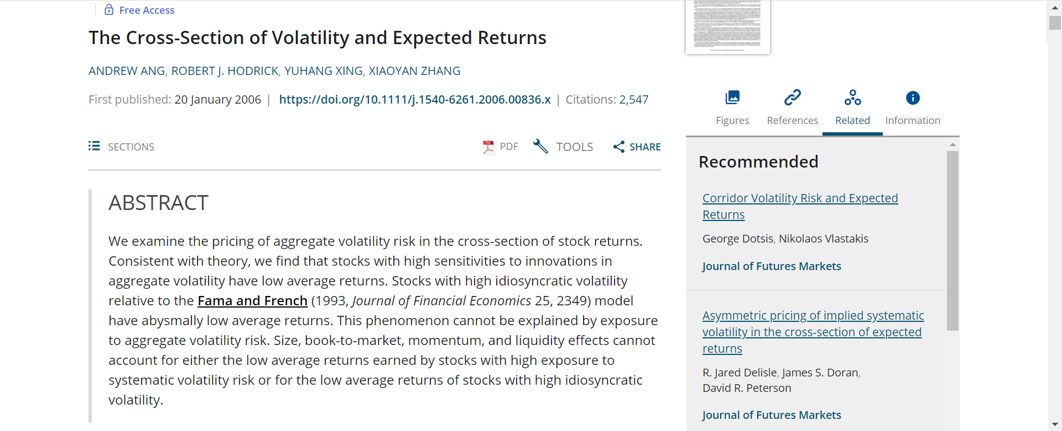
出版细节
Web of Science 引用: 2,547
Google Scholar 引用: 4,857
Notes:
Done.

Slide 13
Motivation
In theory, aggregate volatility affects aggregate expected returns.
  Does aggregate volatility affect cross-sectional average returns?
  The first goal of this paper is to provide a systematic investigation of how the stochastic volatility of the market is priced in the cross-section of expected stock returns.
In theory, idiosyncratic volatility does not affect expected returns.
  If risk-adjustment model is not correct, idiosyncratic volatility may be priced cross-sectionally?
  The second goal of the paper is to examine the cross-sectional relationship between idiosyncratic volatility and expected returns, where idiosyncratic volatility is defined relative to the standard Fama and French (1993) model.
Notes:
In this paper, we mainly discuss two volatilities, the aggregate volatility and the idiosyncratic volatility.
Aggregate volatility is defined to be the volatility of the return on market portfolio. We also call it the market volatility.
Both Campbell and Hentshel, and Golsten et al’s paper find that the aggregate volatility and market expected returns are tightly correlated. From Merton’s intertemporal-CAPM, we know that anything affect the market return can possibly affect the cross-sectional returns. So the first question we want to address is does aggregate volatility affect cross-sectional returns.
The second volatility we discuss is the idiosyncratic volatility, which is the firm-specific volatility that can’t be explained by systematic risks.
Campbell et. Al finds idio. vol increases over time. Goyal et al find that idio. vol predict future market return.
We are curious to find the relation between idiosyncratic volatility and cross-sectional returns.

Slide 14
AggVol: Theoretical Predictions
Merton (1973) and Ross (1976): there are risk premia associated with innovations in the state variables that describe the time variation of investment opportunities.
Campbell (1996) and Chen (2002): market volatility is a state variable for asset returns, which affects investment opportunities, and should be priced.
Market volatility also should carry a negative price.
  Hedge volatility risk or downside risk
  Preference for positive coskewness
Notes:
Now we have two hypothesis: first market volatility is priced, and second, the price is negative.
In cross-section, those two hypothesis means two things: first, if we sort firms with different sensitivities to aggregate volatility into portfolios, those portfolios will have different returns. Second, firms with high sensitivity will have low returns, and firms with low sensitivity will have high returns.

Slide 15
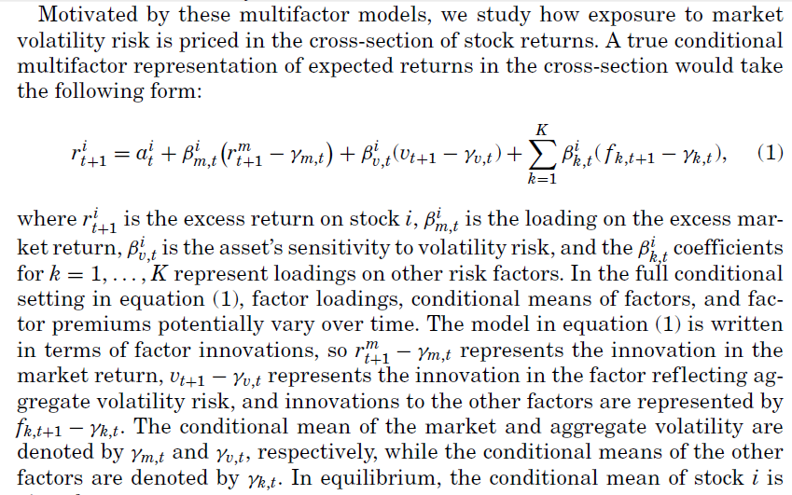
Pricing Implications

Slide 16
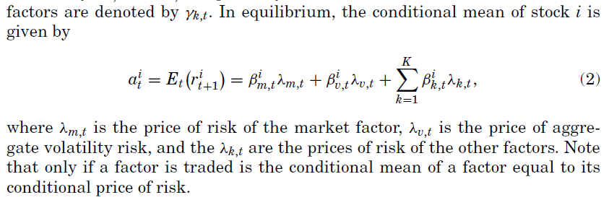
Pricing Implications

Slide 17
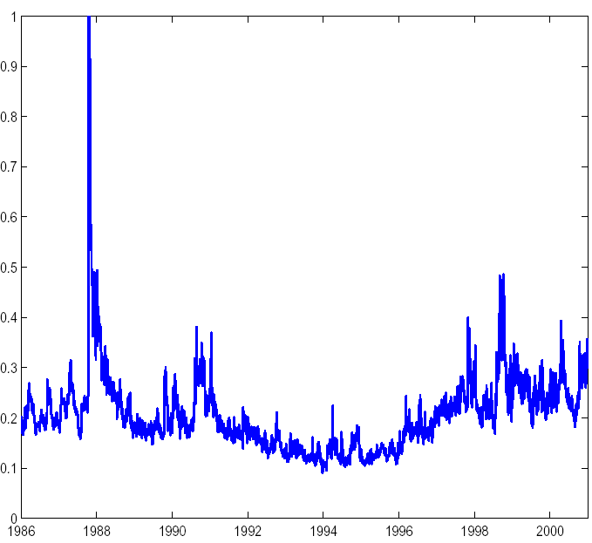
Aggregate Volatility: VIX
Notes:
VIX: Daily implied volatility (from Black-Scholes) of S&P 100 option from Chicago Board Options Exchange
Black and Scholes’ model doesn’t consider jumps, but Bates (2000) argues it doesn’t make big difference.
We don’t separate volatility and associated risk premium.
They share the same trend, two spikes.
VIX is higher than IVOL, because it may incorporate the risk premiums.
IVOL is more volatile than VIX, and it could be jumps during the day. But this makes the regressions a headache.
Innovations are calculated as daily changes in the volatility measure. The innovations are highly correlated with each other (45% and 39%), and they all have negative correlations with the market return.

Slide 18
Empirical Framework
Innovations in volatility state variable
  Because the VIX index is highly serially correlated with a first-order autocorrelation of 0.94, we measure daily innovations in aggregate volatility by using daily changes in VIX, which we denote as ΔVIX.
Concerns
  Implied volatility
  Risk vs. risk premium

Slide 19
Cross-Section Implications
Our factor specification:
  If aggregate volatility is priced, portfolios sorted by their sensitivities to aggregate volatility, , should have different average returns.
    Firms with higher should have lower returns.
    Volatility risk should receive a negative risk price.
  Daily data regression within every month, form quintile portfolios and hold for one month

Slide 20
Portfolios sorted on
Rank | mean | std dev | turnover | % mkt share | Log (size) | B/M | CAPM alpha | FF3 alpha
1 | 1.64% | 5.53% | 0.74 | 9.40% | 3.70 | 0.89 | 0.27% | 0.30%
t-stat |  |  |  |  |  |  | 1.66 | 1.77
2 | 1.39% | 4.43% | 0.78 | 28.70% | 4.77 | 0.73 | 0.18% | 0.09%
t-stat |  |  |  |  |  |  | 1.82 | 1.18
3 | 1.36% | 4.40% | 0.72 | 30.40% | 4.77 | 0.76 | 0.13% | 0.08%
t-stat |  |  |  |  |  |  | 1.32 | 1.00
4 | 1.21% | 4.79% | 0.78 | 24.00% | 4.76 | 0.73 | -0.08% | -0.06%
t-stat |  |  |  |  |  |  | -0.87 | -0.65
5 | 0.60% | 6.55% | 0.73 | 7.40% | 3.73 | 0.89 | -0.88% | -0.53%
t-stat |  |  |  |  |  |  | -3.42 | -2.88
5-1 | -1.04% |  |  |  |  |  | -1.15% | -0.83%
t-stat | -3.90 |  |  |  |  |  | -3.54 | -2.93
Notes:
Here is the results for portfolios sorted on b(dvix), and the sample period is from January 1986 to December 2000.
We have five portfolios. Portfolio 1 has the lowest b(dvix), and portfolio 5 has the highest b(dvix).
From rank1 to 5, the monthly returns are decreasing, and the 5-1 is -1.04% per month, and the big return difference is especially driven by the low return on portfolio 5. So if a firm has high sensitivity to the volatility risk, it will have low returns. This indicates volatility carries a negative risk premium.
In terms of turnover, the five portfolios are pretty much the same. In terms of market share, the low sensitivity portfolio and high sensitivity portfolio are relatively small, and having high B/M ratios. We also report the Jensen’s alphas from CAPM and FF3, what we find is that the last portfolio and the difference between the last portfolio and first portfolio are very hard to price.
To summarize, difference in sensitivity to volatility risk does generate return spreads, high sensitivity gives low returns, which indicates a negative volatility risk premium. The return spread can’t be explained by either CAPM or FF3.

Slide 21
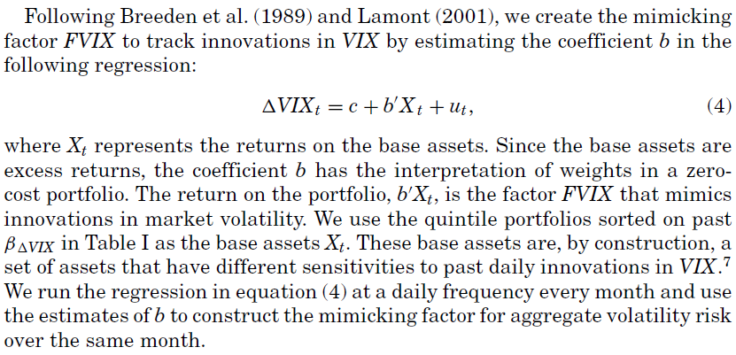
Tracking Portfolios
Notes:
We construct tracking portfolios, whose returns are maximally correlated with realized innovations in volatility. Then we can have an idea whether we can have realized premium related to innovations in volatility.
Daily correlation FVIX and ΔVIX = 0.91, monthly correlation=0.70

Slide 22
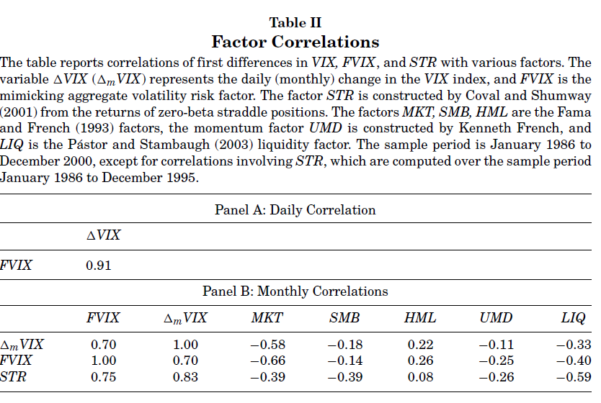
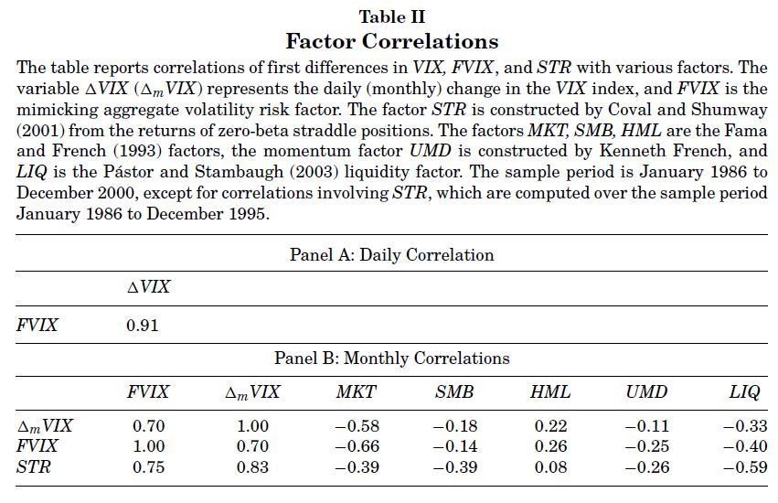

Slide 23
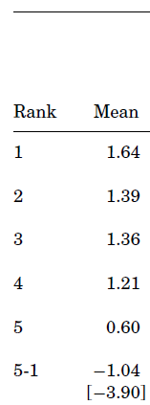
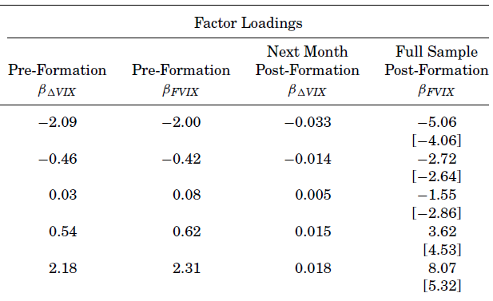
Loadings
Notes:
Results the same using either innovations in AR1 or AR11 for VIX.
Spread is smaller with 3-month window for the daily data regressions. FF3 alpha on 5-th quintile portfolio is -0.37% (t=-1.62) vs. -0.53% (t=-2.93).

Slide 24
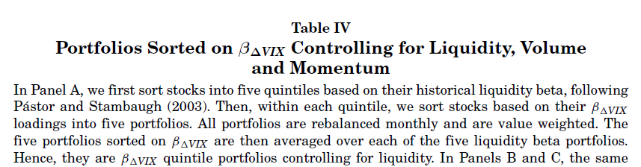
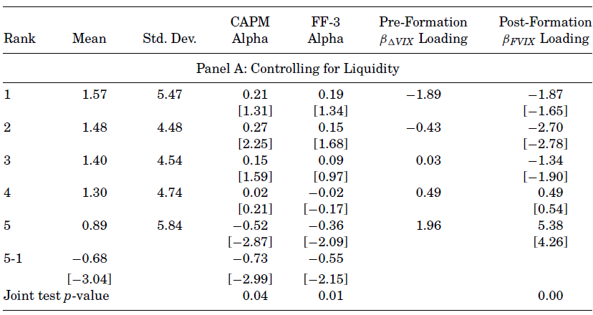

Slide 25
Tradable Volatility Portfolio
Zero-beta straddle returns (STR) as in Coval and Shumway (2001),
  Portfolio of at-the-money call and put options with no sensitivity to market returns but strong sensitivity to market volatility.
  Correlations: STR and FVIX =0.83

Slide 26

Volatility Risk Price: Fama-MacBeth Estimation
Estimation:
  We form 25 portfolios sorted according to sensitivities to market returns and innovations in volatility with daily returns.
  As in Fama-MacBeth, the monthly portfolio returns are regressed on several linear factor models to estimate risk premiums: λ’s.

Slide 27
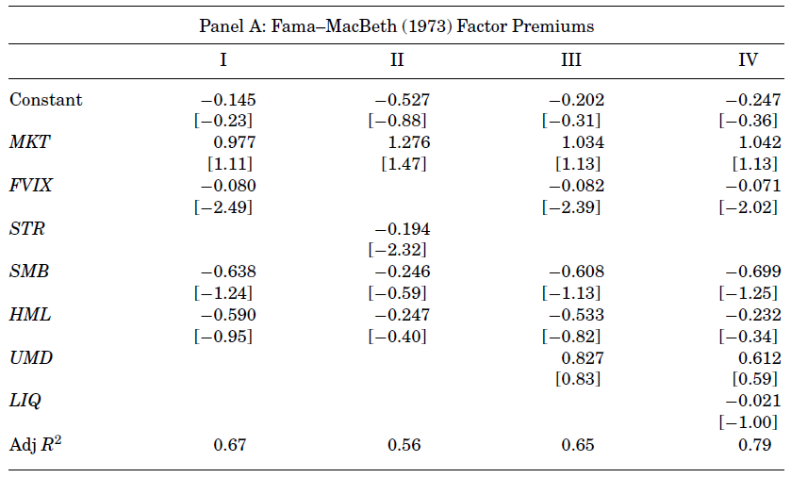
Fama-MacBeth Factor Premiums
Notes:
-1% per year
Look at loadings of portfolio 1 and 5, CVIX can explain most of the 1.04% spread.

Slide 28
Idiosyncratic Volatility
Should idiosyncratic volatility be priced?
  If the model is correct and the market is perfect, idiosyncratic volatility should not be priced.
Caveats:
  Models might mis-specify relevant risks.
  Investors may not want to fully diversify because of asymmetric information or illiquidity.
  Short-sale constraints may prevent arbitrage.
Notes:
What is the idiosyncratic volatility? We can put a firm’s return this way, R=E®+e, E® is specified under some benchmark model, and the e is the idiosyncratic error. Our idiosyncratic volatility is the volatility of e.
The question we ask is should this idiosyncratic volatility be priced?
The common sense answer will be, if the model is correct, and the market is perfect, investor can diversify away the idiosyncratic error, and idiosyncratic volatility shouldn’t matter for cross-sectional returns.
This argument has the following caveats.
There are papers discussing the second and third issue. For instance, Merton (1987) paper point out that if the investor can’t fully diversify the idiosyncratic risk, they would demand higher returns. There are also behavioral papers, like Huang and Barberis, arguing that investor require higher return for higher volatility.
What we are going to do first is to figure out whether idiosyncratic volatility matters at all for cross-sectional returns, and then we discuss possible explanations.

Slide 29
Estimate Idiosyncratic Volatility
We measure systematic risk with the FF3 model:
  We measure idiosyncratic volatility as the square root of var(ε_{t}^{i})
Notes:
In this paper, we choose CAPM and FF3 to be the benchmark model to calculate the idiosyncratic volatility. I will mainly discuss the results using FF3.
Of course, we are under the critique of model dependence. But in fact, we find the results is pretty robust to the choice of existing models.

Slide 30
Idiosyncratic Volatility Sorted Portfolios
Rank | mean | std dev | Turn over | % mkt share | Log (size) | B/M | CAPM alpha | FF3 alpha
1 | 1.04% | 3.83% | 0.41 | 53.50% | 4.86 | 0.85 | 0.11 | 0.04
t-stat |  |  |  |  |  |  | 1.57 | 0.99
2 | 1.16% | 4.74% | 0.64 | 27.40% | 4.72 | 0.80 | 0.11 | 0.09
t-stat |  |  |  |  |  |  | 1.98 | 1.51
3 | 1.20% | 5.85% | 0.68 | 11.90% | 4.07 | 0.82 | 0.04 | 0.08
t-stat |  |  |  |  |  |  | 0.37 | 1.04
4 | 0.87% | 7.13% | 0.65 | 5.20% | 3.42 | 0.87 | -0.38 | -0.32
t-stat |  |  |  |  |  |  | -2.32 | -3.15
5 | -0.02% | 8.16% | 0.42 | 1.90% | 2.52 | 1.10 | -1.27 | -1.27
t-stat |  |  |  |  |  |  | -5.09 | -7.68
5-1 | -1.06% |  |  |  |  |  | -1.38 | -1.31
t-stat | -3.10 |  |  |  |  |  | -4.56 | -7.00
Notes:
Again, now we sort firms into five portfolios according to their idiosyncratic volatilities. The first portfolio has the lowest idio. vol, and the last portfolio has the highest idio. vol.
Now we don’t have a monotonic pattern, the first three portfolios have roughly the same returns, and the last two portfolios have lower returns. The return difference is 1.06% per month. So first of all, we know that idio volatility does matter for cross-sectional returns.
But in terms of the pattern, remember Merton’s paper argue that firms with high idio vol should have higher returns, our result is just the opposite.
Then in terms of turnover, first and last portfolio are less traded. The last portfolio contains particularly small firms and high B/M firms. This is also contradictory to FF3. Because according to FF3, small firms with high BM should have higher returns. So no wander that the alphas from CAPM and FF3 are pretty big for the last portfolio.
Since the return spread is mainly driven by the last portfolio, and it is pretty small, we conduct several robustness checks.

Slide 31
Possible Explanations
NYSE vs. Nasdaq stocks
Size
Book to Market
Leverage
Liquidity
Volume
Turnover
Bid-Ask Spread
Dispersion in analyst forecasts
Momentum
Risk Premium

Slide 32
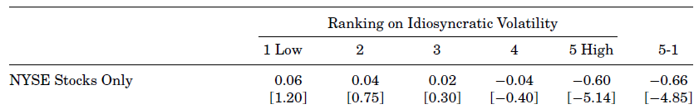
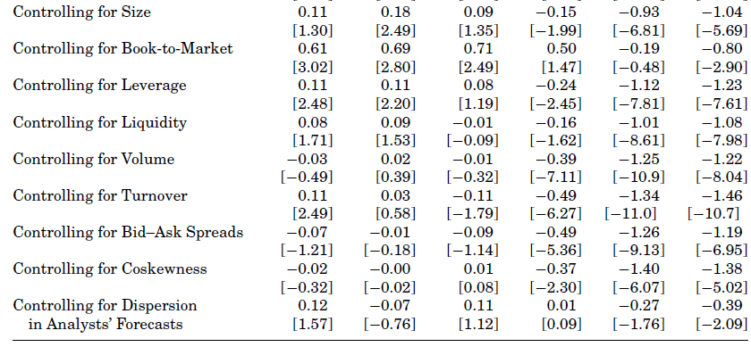
Robustness
Notes:
The first concern was raised by Swami, who is not here today. He said probably the results are driven by the tiny tech firms listed on Nasdaq. So we take our Nasdaq firms, we only use NYSE firms. By using only NYSE firms, the spread is getting smaller somehow, but it is still big and significant.
In terms of size, we control for that by doing double sort. We first sort on size and then on idio vol. What we found is that the spread is actually the biggest for the mid-sized firms. So controlling for size doesn’t solve our problem.
In terms of B/M, as we already saw, last quintile has the highest BM. We doublesorted. We first sort on B/M, then sort on idio. vol, and the pattern is still there and strong.
Since small firms are usually linked with low liquidity and low volume, we also check those.
Volatility is pretty consistent. So if the firms have high volatility and low return this period, it will probably continue to do that next period. So we also check the momentum.
In the end, we examine analyst forecast dispersion. As in Diether, Malloy and Schbina’s paper, firms with high analyst forecast dispersion should have higher returns, because those firms have higher uncertainties associated with them. This is actually quite in line with our results. So we did a double sort on that, but we still have a return spread of 0.4% per month.
Note that this one in fact achieves the smallest alpha. We did check whether our volatility effect explains their dispersion effect. Quite strikingly, if we control for the idio. vol, there is no spread along the dispersion dimension.
To summarize, we find our results are pretty robust and they are different from other results. So next, we try standard risk stories.

Slide 33
Can We Explain It?
Behavioral explanations
  Over/under-reaction?
    If over/under-reaction, over the long holding period, it will converge back to zero.
  Short term corporate event?
    If we increase the forming period, the return spread is not going to be big.
Notes:
We first try the behavioral explanations.
As you see, to test this, we need to check the effect over different horizons.

Slide 34
Fama-French alphas for alternative strategies
 | Rank
Strategy | 1 | 2 | 3 | 4 | 5 | 5-1
1/1/1 | 0.06 | 0.04 | 0.09 | -0.18 | -0.82 | -0.88
 | 1.47 | 0.77 | 1.15 | -1.78 | -4.88 | -4.63
1/1/12 | 0.03 | 0.02 | -0.02 | -0.17 | -0.64 | -0.67
 | 0.91 | 0.43 | -0.37 | -1.79 | -5.27 | -4.71
12/1/1 | 0.04 | 0.08 | -0.01 | -0.29 | -1.08 | -1.12
 | 1.15 | 1.32 | -0.08 | -2.02 | -5.36 | -5.13
12/1/12 | 0.04 | 0.04 | -0.02 | -0.35 | -0.73 | -0.77
 | 1.1 | 0.54 | -0.23 | -2.8 | -4.71 | -4.34
Notes:
So we form portfolios over different horizons.
The first digit is forming period, over which we estimate the volatilities.
The second digit is how long we wait between forming period and holding period.
The third digit is the holding period, we form portfolios and we hold on to it.
The first strategy is quite close to what we have discussed before.
The second strategy use one month data to estimate the volatility, then hold it for 12 month. If there is a over-reaction or under-reaction, it will go away over 12 month, and that is not the case.
The third strategy use 12 month data to estimate the volatility, so we can reduce the impact of short-run effect, but the pattern is still there.
So we think the behavioral explanations don’t work well.

Slide 35
Can We Explain It?
Business cycles
  Bull and bear markets?
  Recessions and expansions?
  Extremely volatile periods?
It remains a puzzle to us.
Notes:
The last thing we try is subperiods.
We check whether the effect is over particular period, bull or bea, recession or expansion, ...
It turns out we just couldn’t go away.
So it is a puzzle for us, why the idiosyncratic vol matters for cross-sectional returns, we are looking forward to new explanations or new models.

Slide 36
Conclusion
Aggregate volatility and expected returns
  Theoretically, stochastic market volatility is a risk factor and should affect the cross-section of expected returns.
  The portfolio with high sensitivity to aggregate volatility underperforms the low sensitivity portfolio by 1.04% per month.
  The price of volatility risk is significantly negative.
Idiosyncratic volatility and expected returns
  The highest idiosyncratic volatility portfolio underperforms the lowest idiosyncratic volatility portfolio by 1.06% per month.
  Exposure to aggregate volatility risk is not the explanation.
  Other existing risk and behavioral explanations fail to explain the spread, and it remains a puzzle to us.
Notes:
Theoretically,
Campbell and Chen, people want to hedge away high volatility risk, which is associated with low returns
Harvey and Siddique, high return with high volatility means positive coskewness, it is expensive, because people might have preference over coskewness.
Bakshi and Kapadia, downside risk

